Slide 1
Quality Planning and Performance
Introduction to RL:
Electronic Reporting of Events
Regional Leadership Team June 4, 2024
Notes:
Introduce self

Slide 2
What does RL mean?
Notes:
What does RL mean? No – not regional leadership!
RL stands for Radical Logics (confirm with Alison)…and all this time I thought it meant Realtime Learning

Slide 3
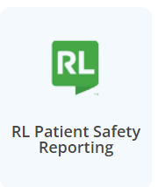
What is RL?
RL is the Provincial web-based reporting system that captures both safety events and public feedback.
To do this, there are two separate programs:
Risk – captures patient safety events
Feedback – captures compliments and concerns
Notes:
RL is an electronic reporting system of both safety events and public feedback.
This is the icon staff will click on to access the RL system.
Staff will have access to the patient safety event reporting system.

Slide 4
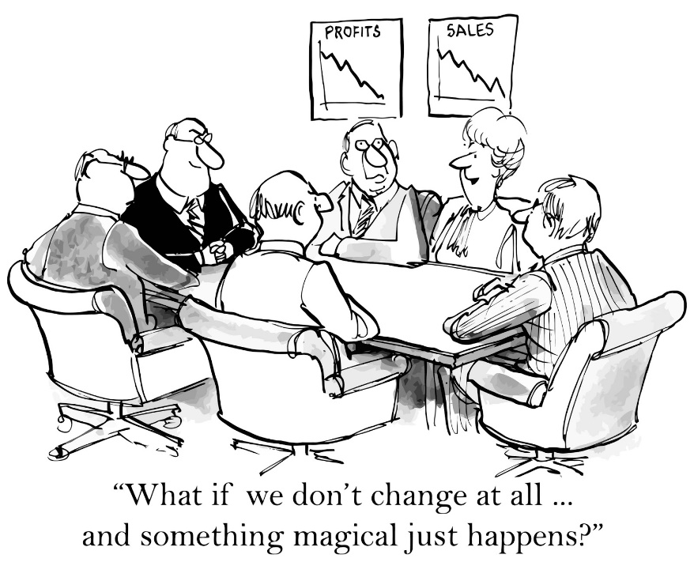
The benefits of change
An online system will:
standardize reporting
generate local and provincial reports
identify and analyze trends related to patient safety and patient feedback
Notes:
Provincial electronic reporting will provide real time data
It will allow standardized reporting and the ability to see what is happening at a regional and provincial level
This will help in identify trends for analysis for the patient safety and patient feedback

Slide 5
Who will use RL?
Healthcare staff will learn the new safety event reporting system.
Managers will be able to run program reports on trending issues.
Notes:
All health care staff will have access to the reporting system through.
Managers will be able to run reports on real time issues that are trending on their units.

Slide 6
When will RL Roll Out?
Notes:
At the moment, the provincial team anticipates we will begin out roll out in September/October.

