Slide 1
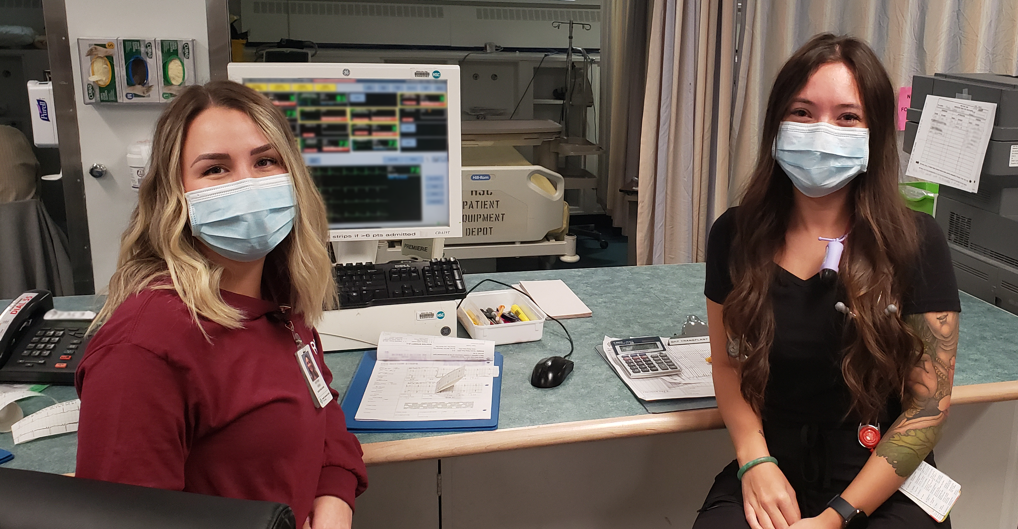
NURSING MENTORSHIP PROGRAM

Slide 2
The spirit of mentoring
When the mentee speaks with a voice of doubt, the mentor engages the voice of knowledge.
When the mentee speaks with the voice of fear, the mentor engages the voice of courage.
A mentoring relationship fans the flames of passions and dreams.

Slide 3
What is mentorship?
A voluntary, mutually beneficial, and long-term relationship.
An experienced and knowledgeable leader (mentor) supports the maturation of a less-experienced nurse with leadership potential (mentee).

Slide 4
What is involved in mentoring?
The mentor is expected to have regular contact with their mentee.
The relationship is structured with goals and objectives.
The manner in which they meet is flexible and based on the needs of the mentor and mentee and can be adapted and added to as required.

Slide 5
Objectives
Prioritization: assisting to review workload when invited to do so and in the assessment of prioritizing tasks.
Organization: assisting in planning the day with the assignments, skill consolidation, mastering the work schedule, how to do a shift swap, etc.
Working with physicians and other team members: when to call, who to ask, what to ask, how to develop the relationship, etc.
Imparting knowledge: “this has worked for me in similar situations”, guiding decision making, problem solving, suggestions for charting, etc.

Slide 6
Objectives
Resources: what resources are available, how to access, who you ask.
Emotional Intelligence: understanding self, management of self, understanding and managing others, conflict resolution, relating to patient, resident, client, family, delegation, working with interprofessional team.
Critical thinking: analysis, reasoning, inference, interpretation, knowledge, and open-mindedness to impart judgement in clinical decisions.

Slide 7
Measurement
The manager will regularly review the goals and objectives of the mentorship arrangement with the mentor and mentee
The mentee will self-evaluate their comfort level at the commencement of the mentorship relationship.
A similar self-evaluation will also occur at the mid and end points of the formal mentorship.
The mentor may also choose to participate in this evaluation if the mentor and mentee agree.

Slide 8
I would like to be a mentor
Indicate your interest in becoming a mentor to your manager.
Your manager may also approach you to ask if you are interested in being a mentor.
The formal mentorship relationship is anticipated to be in place for a period of approximately 6 months.
That does not limit the mentor and mentee from continuing an informal mentorship relationship beyond six months.

Slide 9
Compensation
Mentors are entitled to be paid $0.70/hour for each hour assigned as a mentor to a new graduate.
Mentors will be compensated by receiving $0.70/hour on 50% of their regularly scheduled hours in the 6-month mentorship period.

Slide 10
I would like to be mentored
The manager informs new graduates (nurses in their first year of practice) that they are eligible to be assigned a mentor.
The manager will select from the pool of available mentors the individual they feel would best fit the new graduate’s personality, skill set and availability.

Slide 11
Can I have a mentor if I’m not a new grad?
The Memorandum of Understanding Re: Mentorship that is in the Collective Agreement applies only to new graduates (nurses in their first year of practice).
That does not prevent an experienced nurse in a new environment from requesting a mentor, however, this would not fall within the parameters of the Collective Agreement and would be compensated on a non-monetary basis.

Slide 12
The possibilities are endless…
…one merely needs to step forward.

Slide 13
Questions?

