Slide 1







WHAT MATTERS
TO YOU?
Asking, Listening, & Doing
“What Matters”
Introducing
‘What Matters to You’ to Staff
From Concept to Practice
Notes:
Hello everyone- thank you for taking the time to learn more about the People Centred Care Strategy for Southern Health-Sante Sud. This presentation is meant to give you some background about the What Matters to You Initiative and also give you and your team the opportunity to practice using some of the tools so you can build confidence using them in your work environments.

Slide 2


Ice Breaker- What Matters to You Activity
Think about what matters to you
Fill in the blank space
Notes:
We are going to jump right in by asking each of you to fill out either a printed version of this handout or using a blank piece of paper. Think about what matters to you and fill in the blank space. Please pause this presentation so everyone has a few minutes to complete this activity.

Slide 3
Ice Breaker- Debrief
How did filling that out make you feel?
*feel free to pause the presentation for group discussion
Notes:
Thank you for participating. I’d like to ask: “How did filling that out make you feel?” Was it awkward to start? Were you clear on what the question was asking? Were you able to just start writing or did you second-guess a lot of the things going through your mind?
Feel free to pause this presentation and share amongst your group.
Many of the things you are feeling will be similar to the feelings your patients, residents and their family members will have when asked the same question. We are going to jump into the presentation now but keep this idea in the back of your mind as we discuss more about the What Matters to You concept and how to put it into practice.

Slide 4
Agenda
Introduce you to ”What Matters to You?”
Benefits to joining the movement
Motivate you to try it!
Brainstorm opportunities to incorporate What Matters to You…
Notes:
So today’s agenda is fairly simple- we want to introduce you to What Matters to You, explain some of the benefits of joining the movement which will hopefully motivate you to try it out! Lastly, we are going to start brainstorming how this concept can be incorporated into your work practices so that our region can really start leading the charge of people-centred care in a more organized and supported way.

Slide 5

Have you ever asked anyone
‘What Matters to You’ at work?
With co-workers?
With patients, residents, clients, family members?
*feel free to pause the presentation for group discussion
Notes:
I’d like to ask for a show of hands in your group…
Have you ever asked What matters to You with co-workers? How about with patients, residents, clients or family members?
If the answer is no, that’s okay. But I’d like you to think about why you haven’t thought of that before.
If the answer is yes, how did that conversation go? What did you learn? Were you able to do anything with what you heard?

Slide 6
Global: What Matters to You Across the World
Notes:
It’s important to know that The What Matters to You movement is a global healthcare movement. It originated in Scotland and has spread throughout the world- across cultures, language, demographics, etc. In Canada, it is most known in British Columbia through the BC Voices Network which means there are many examples of resources, ways it has been put into practice, and lessons learned already established.

Slide 7
A simple approach
What Matters to You is a health care movement that prompts health care providers to add one simple question to every patient interaction, each and every day, in order to improve care.
That question is,
“What matters to you?”
With a simple goal of encouraging meaningful conversations between patients, caregivers, families, and their health care providers, What Matters to You has demonstrated improvements in both patient and staff experience and engagement.
Notes:
What Matters to You isn’t just a phrase- it’s a health care movement that prompts health care providers to add one simple question to every patient interaction, each and every day, in order to improve care.
That question is,
“What matters to you?”
With a simple goal of encouraging meaningful conversations between patients, caregivers, families, and their health care providers, What Matters to You has demonstrated improvements in both patient and staff experience and engagement.

Slide 8
The What Matters to You Method
Actionable?
Ask
What Matters?
Listen
To What Matters
Do
What Matters
REFLECT
On What Matters
What Else Matters?
Credit: Damara Gutnick, MD 2019
Notes:
It really is as simple as ASK LISTEN DO
We want our staff to ask What Matters to people, Listen to what they have to say- determine if it’s actionable and if it is- do what matters. If it’s not actionable, reflect on it and find out if there are other things that matter to the person in front of you.

Slide 9
Different Ways to Ask “What Matters to You?”
What is important to you at the moment?
What would you like to achieve as a result of our work together?
What can I do to best support you in your care today?
For your care, what’s your ideal scenario?
Is there anything else you want to tell me that I haven’t asked about?
What are your goals and how can I help you achieve them?
Notes:
There are many ways to ask What Matters to You. Choose a few that feel comfortable to you.
Would you have different answers if someone asked you, “For your care, what’s your ideal scenario?”
Or how about “What are your goals and how can I help you achieve them?”
These questions really prompt someone to consider important aspects of their health and their healthcare experience.

Slide 10
What is different about these 2 questions?
What’s the matter WITH you?
What matters TO you?
*feel free to pause the presentation for group discussion
Notes:
In your group today, I’d like you to discuss the differences between asking What’s the matter WITH you AND What Matters TO you?
What assumptions do the questions make?
What does it say about the power dynamics?

Slide 11

Staff Engagement
WMTY conversations help healthcare teams to better understand each other, leading to higher collaboration, reduced provider burnout, and improved care delivery through process improvement.
Improved Joy in Work
Increased Retention
Increased Organizational Partnership
Notes:
The What Matters to You movement has proven benefits to staff which you can see on this slide. It brings meaning into your workplaces and has shown improved joy in work which increases retention and connection with the organization overall.

Slide 12
What is Joy in Work?
The emotion of pleasure, feeling of success, and satisfaction as a result of meaningful action.
Intellectual, behavioral, and emotional commitment to meaningful and satisfying work.
Joy is about having a personal impact: if you reconnect with joy and purpose in your work, it increases compassion and empathy and improves physical and mental health.
Productivity ↑ 31% Accuracy ↑ 19%
Notes:
Let’s talk more about joy in work since it’s something we could all use a bit more of these days I’m sure. Joy in work is the emotion of pleasure, feeling of success and satisfaction as a result of meaningful action. It’s the intellectual, behavioral and emotional commitment to meaningful and satisfying work.
Joy is about having a personal impact- if you reconnect with joy and purpose in your work, it increases compassion and empathy and improves physical and mental health. There are many studies that show that joy in work increases productivity AND accuracy. So it really is a win-win for the organization and for individual staff members. And in turn- it will certainly have positive impact on those we serve in our facilities and programs.
REFERENCES
Lucian Leape Institute. 2013. Through the eyes of the workforce: creating joy, meaning and safer healthcare. Boston, MA: National Patient Safety Foundation.
Sirota D & Klein D. (2013) The Enthusiastic Employee: How Companies Profit by Giving Workers What They Want
Anchor, S, (2010), The Happiness Advantage: Seven Principles of Positive Psychology That Fuel Success and Performance at Work.

Slide 13
What joy is not…
Something you announce
Flavor of the month
Superficial one-time actions
Pizza parties
Tokens not linked to purpose, e.g. ‘thank you’ notes
Something done ‘to’ or ‘for’ team members as opposed to ‘with’ team members
Notes:
Just a note for those people who think that joy is derived from one-time actions or treats or tokens… these types of action may have momentary moments of joy associated with them but true joy is only derived from finding meaning in your work and knowing that you made an impact.

Slide 14
What happens when joy is missing?
Lower levels of empathy
More mistakes
Lower patient satisfaction
Reduced adherence to treatment plans
Overuse of resources
Lucian Leape Institute. 2013. Through the eyes of the workforce: creating joy, meaning and safer healthcare. Boston, MA: National Patient Safety Foundation.
Notes:
And when joy is missing from the work place, we see lower levels of empathy, more mistakes, lower patient satisfaction, reduced adherence to treatment plans and overuse of resources. These certainly all relate to quality and patient safety. We need to infuse this back into our workplaces in as many ways as possible- but it has to be through meaningful work- not more tasks.

Slide 15

Questions for Discussion
Does our work environment need more joy in work?
How might incorporating What Matters to You conversations in our workplace help improve joy in work?
*feel free to pause the presentation for group discussion
Notes:
In your team today, please discuss the consider the following questions-
Could your work environment use more joy in work?
And how might incorporating what matters to you conversations in your workplace help with that?

Slide 16

Where do we start?
Start small and keep it simple. A simple act could have a big impact on patients and staff.
Get comfortable with the suite of What Matters to You tools
Work with your team members to brainstorm ways to embed the tools and culture in your work environment
Evaluate and make improvements as you join the movement
Each person has an opportunity to impact people-centred care
Notes:
So where do we start? It’s important to realize that small acts can have a big impact on both patients and staff so you just have to start somewhere. A few suggestions are listed on this slide. Get comfortable with the suite of tools that have been developed for you- we’ll discuss those more in the slides ahead. Work with your team to brainstorm ways to embed the tools and culture of What Matters to You into your work environment. And then keep checking in and making improvements as you go. We know that there are ways to adapt the concept in all work environments and has been tested with all kinds of examples and tools to help support you. Don’t be afraid to jump in and join the movement!

Slide 17

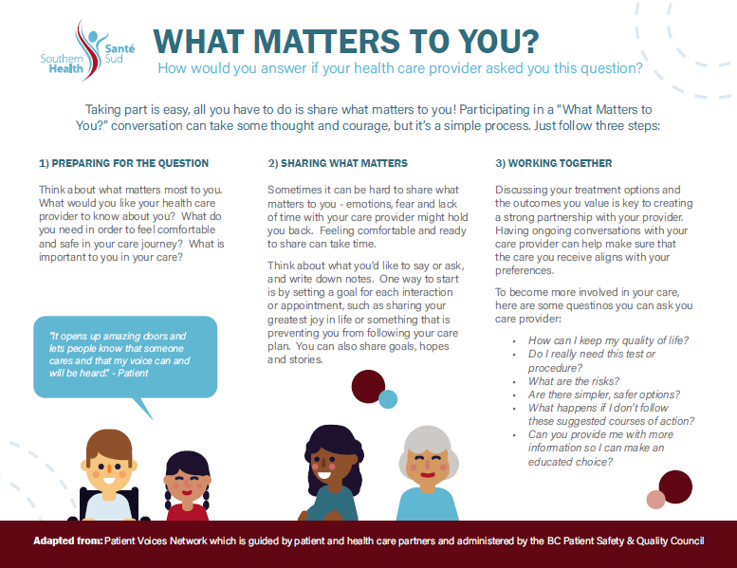
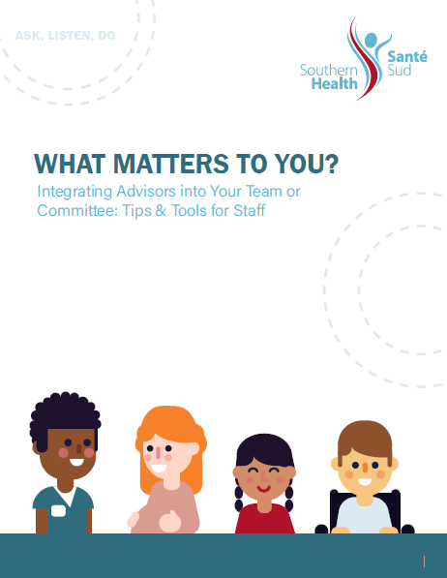
Suite of Matching Tools
Majority developed with patient/public input
Notes:
This is a sample of some of the tools that have been developed to support the work you may want to do. You’ll notice a consistent look and feel with a variation of burgundy and teal stripes along the bottom of the documents to differentiate tools for patients and public and tools for staff.

Slide 18
Suggested Tools/Resources
Tools for Public
Tools for Staff
Bedside Tool with information brochure
Bedside
What Matters to You Intro 1-pager
1-time
Quick Tips for 1-Time Engagement Opportunities
Ongoing
Integrating Advisors on Teams
Sharing Your Story
Health Care Advisor Handbook
Notes:
This is the graphic you will currently find on the Health Provider site under staff resources/what matters to you.
There are tools for public and tools for staff based on the depth of engagement opportunity you’d like to pursue. So if you’d like to try What Matters to You at the bedside, we have a tool for that. If you’d like to try a one-time interaction at a staff meeting with a community member who could share their story, we have tools for that. And if you’re ready to dive right in and start having patients or public members as regular partners in your team meetings, we have tools to help support that work.
Just a note here that we will be adding more items to the website as they are developed or requested. This is just a way to organize a handful of tools as we launch the initiative. More is already being developed and considered. We are also working on some tools to support multicultural engagement efforts as well.

Slide 19
Notes:
This is a closer look at the bedside tool and accompanying info sheet as you experienced at the beginning of this presentation. It was developed to consider a bilingual format and a variety of ages and literacy levels. For instance, if a young child is given this during their hospital stay, they would be able to illustrate some of the things that matter to them. This tool could be used on white boards in our acute and transitional facilities and potentially on doors outside of rooms in our long term care housing facilities.

Slide 20

This booklet is to help support people who would like to share their experiences with health care providers.
It has some ideas about how to prepare for sharing a story in the safest and most effective way.
The staff version has lists of ways to best support the storyteller while listening attentively to what is being shared.
Notes:
The second set of tools can be used when you want to hear from patients or clients in a meeting or team environment. The patient booklet helps the storyteller share their story in a safe and effective way and the staff booklet helps the team prepare for hearing difficult stories, checklists for supporting the storyteller and considerations for how to use the information heard afterwards.

Slide 21

A 3rd tool was created to help clarify the role of health care advisors- for ongoing participation in leadership meetings, etc
The accompanying staff tool is a compilation of material to help facilitate ongoing engagement strategies.
Notes:
The last tool is when your team is ready to jump deeper into engagement efforts by having advisors as part of your leadership teams on a regular basis. Having members of the public join you around the table as equal partners will help your team gain new perspectives and understanding of the users of your program or service. These tools will help you navigate this more complex engagement strategy. For those of you who have unmet criteria with accreditation standards related to people centred care and hearing from patients and clients, this is the tool that you might want to start with. It will give you everything you need to get started in meaningful engagement efforts.

Slide 22
Group Work: Brainstorm
How can we can embed the What Matters to You approach into our work place?
What is first thing we will commit to as a team?
*feel free to pause the presentation for group discussion
For future brainstorming or resource development, contact the Planning Team at tbraun@southernhealth.ca
Notes:
In closing, I’m encouraging your team to discuss the following questions:
How will you get started and what will you commit to as a team?
Thank you for your attention and engagement today. We look forward to connecting with you again in the future about this valuable initiative

